Slide 1
ECIII/ECSI 3206: Artificial Intelligence [and expert systems] Topic 2: Agents in A.I
By: Edgar Otieno

Slide 2
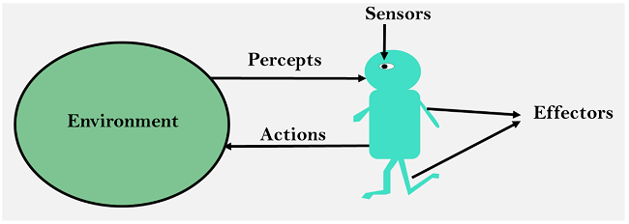
A.I agents
Anything that can perceive its environment through the use of sensors and act on its environment through the use of Effectors

Slide 3
Agent Classifications
Human agents[use organs]
Robotic agents[use cameras, sensors and motors]
Software agents[Use programs/bits and bytes]

Slide 4
Agent terminologies
Agent function-[is the map from percept sequence to action sequence]
Rationality-[ability to be reasonable , sensible and have good sense of judgment]
Ideal rational Agent-[one that is capable of taking action to maximize its performance based on percept sequence and built in knowledge]
Agent architecture-[machinery that an agent acts on]
Agent program-[an implementation of agent function]

Slide 5
Factors affecting rationality of an Agent
Performance measures
Agent percept sequence
Agent prior knowledge about the environs
Actions that an agent is allowed to carry out

Slide 6
Types of agents based on functioning
Simple Reflex Agents
Model based reflex agents
Goal based agents
Utility based Agents

Slide 7
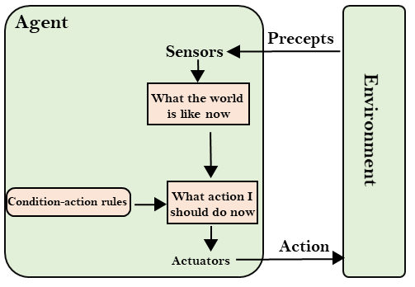
1. Simple Reflex agents
They choose their actions based on percept sequence
Have very little intelligence
Any change in their environments requires collection of new rules
Their environment is completely observable[e.g mail sorting robot]

Slide 8
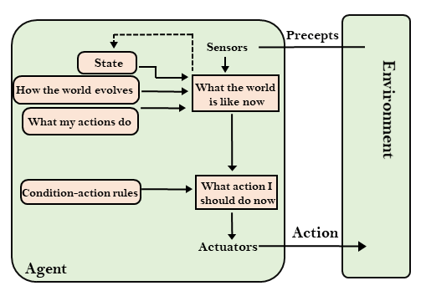
2. Model based reflex agents
Choose the best action based on real world model.
They maintain an internal state which is unobserved aspects of the current state depending on the percept history.[e.g simple vacuum cleaner]

Slide 9
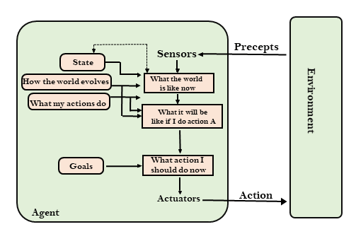
3. Goal based Agents
Are agents that choose their actions in order to achieve a specific goal.[goal=desired state/situation]
It is more flexible than model based reflex agents[e.g google waymo driverless car]

Slide 10
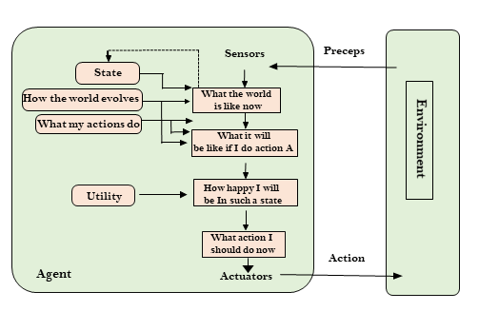
4. Utility based Agents
Choose action based on preference /utility for each state

Slide 11
5.Learning Agents[still evolving]
Learning Agent
A learning agent in AI is the type of agent which can learn from its past experiences or it has learning capabilities. It starts to act with basic knowledge and then able to act and adapt automatically through learning.
A learning agent has mainly four conceptual components, which are:
Learning element :It is responsible for making improvements by learning from the environment
Critic: Learning element takes feedback from critic which describes how well the agent is doing with respect to a fixed performance standard.
Performance element: It is responsible for selecting external action
Problem Generator: This component is responsible for suggesting actions that will lead to new and informative experiences.

Slide 12
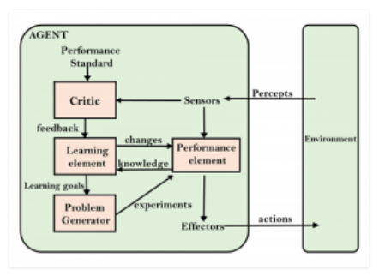
Learning agent diagram

Slide 13
Agent Environments and their properties
Discrete vs Continuous environments
Observable vs partially observable environments
Episodic vs non Episodic environments
Deterministic vs non deterministic environments
Accessible vs inaccessible environments
Static vs Dynamic environments
Single Agent vs Multi Agent Environments

Slide 14
Task environment elements when designing intelligent agents
Performance measures
Environment itself
Actuators
Sensors
[examples of Vacuum cleaner or Taxi Cab]

Slide 15
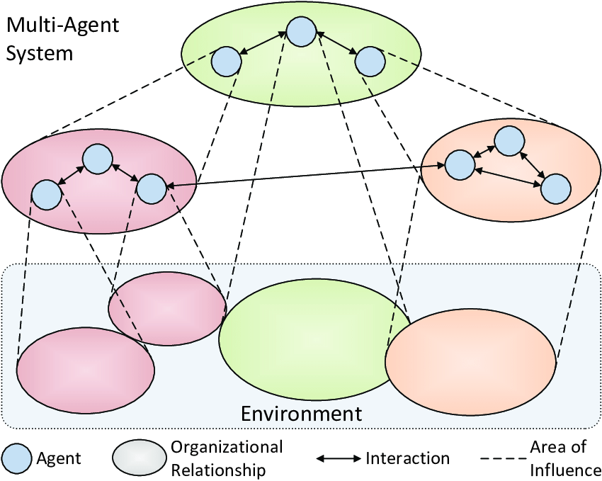
Multi-Agent Systems[MAS]
It’s a collection of multiple autonomous intelligent agents each acting towards its objectives while interacting in a shared environment i.e complex interaction of simple units

Slide 16
Advantages of M.A.S
Solve problems that are too large for a single agent to solve
Reduce the risk of failure
Solve autonomous problems

Slide 17
Properties of Autonomous Agents
Reactive [action driven by events] vs Proactive [agent takes initiative]
Sociable [interacts with other agents thru’ cooperation, coordination or negotiation]
Competitive[each agent has a different utility] vs cooperative[shared utility]

Slide 18
Characteristics of M.A.S
Each agent has incomplete information/ ability
Data is decentralized
Computation is asynchronous
There is no global system control

Slide 19
Applications of M.A.S
Computer games
Supply chain management
Air traffic control
Search and rescue [ Unmanned vehicles with distributed sensors]
Robocup
Intelligent transport systems
Automated manufacturing industries

